Slide 1
Announcements
Turn in exam revisions
Homework 5 due Tuesday after break. Turn in Word doc (or other file I can open) on Canvas
Moving to remote learning…

Slide 2
Transition to Remote
Turn on Canvas notifications!
Discussion board
Lectures will be over Webex
Live with chat and recorded
Lecture materials still posted as usual
Office hours will be over Webex
Labs will be asynchronous and use R Studio Cloud [demo]
Test your setup before class starts again!

Slide 3
Questions from last time
Is a log-normal distribution produced by the log of normally distributed values?
No. If x is log-normally distributed, then log(x) has a normal distribution.

Slide 4
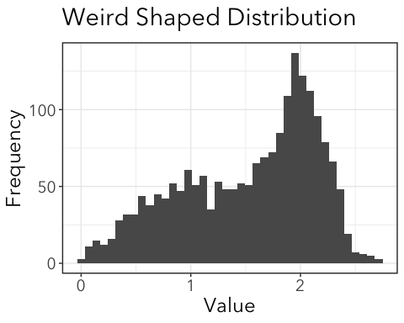
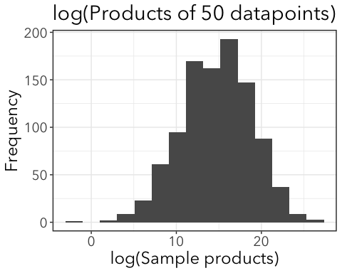
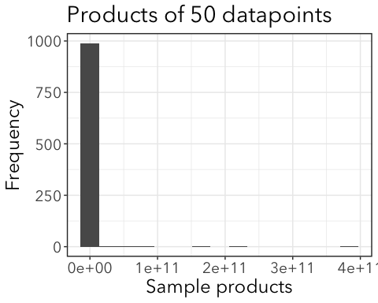
Why so common?
The product of a large number of samples from any positive (>0) distribution will be log-normally distributed.
Notes:
log or exp????

Slide 5
Questions from last time
Is a log-normal distribution produced by the log of normally distributed values?
Can you do glm(mass ~ -1 + treat*host, family = gaussian, data = cats)?
Not quite that easy…

Slide 6
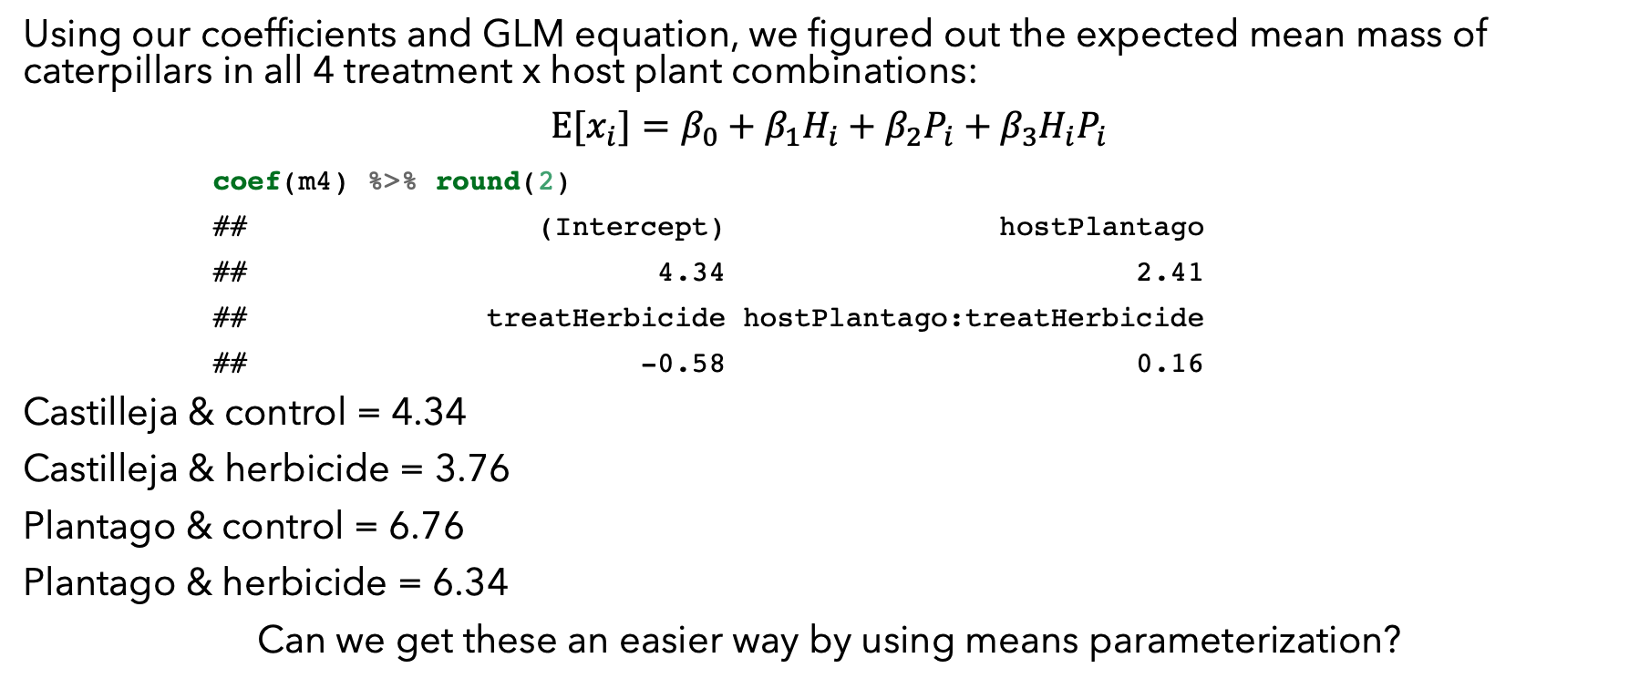
Review of means vs. effects parameterization
Using our coefficients and GLM equation, we figured out the expected mean mass of caterpillars in all 4 treatment x host plant combinations:
$$E[x_{i}]=β_{0}+β_{1}H_{i}+β_{2}P_{i}+β_{3}H_{i}P_{i}$$
coef(m4) %>% round(2)
## (Intercept) hostPlantago ## 4.34 2.41 ## treatHerbicide hostPlantago:treatHerbicide ## -0.58 0.16
Castilleja & control = 4.34
Castilleja & herbicide = 3.76
Plantago & control = 6.76
Plantago & herbicide = 6.34
Can we get these an easier way by using means parameterization?

Slide 7
Effects parameterization
m_effects <- glm(mass ~ treat*host, family = gaussian, data = cats) summary(m_effects) ## Coefficients: ## Estimate Std. Error t value Pr(>|t|) ## (Intercept) 4.3444 0.2193 19.806 < 2e-16 *** ## treatHerbicide -0.5844 0.3162 -1.848 0.0657 . ## hostPlantago 2.4144 0.2778 8.690 3.14e-16 *** ## treatHerbicide:hostPlantago 0.1639 0.3998 0.410 0.6821 ## --- ## Signif. codes: 0 '***' 0.001 '**' 0.01 '*' 0.05 '.' 0.1 ' ' 1 Anova(m_effects)
## Analysis of Deviance Table (Type II tests) ## ## Response: mass ## LR Chisq Df Pr(>Chisq) ## treat 6.200 1 0.01278 * ## host 155.777 1 < 2e-16 *** ## treat:host 0.168 1 0.68177 ## --- ## Signif. codes: 0 '***' 0.001 '**' 0.01 '*' 0.05 '.' 0.1 ' ' 1
✓

Slide 8
Means parameterization
m_means <- glm(mass ~ -1 + treat*host, family = gaussian, data = cats) summary(m_means) ## Coefficients: ## Estimate Std. Error t value Pr(>|t|) ## treatControl 4.3444 0.2193 19.81 < 2e-16 *** ## treatHerbicide 3.7600 0.2278 16.51 < 2e-16 *** ## hostPlantago 2.4144 0.2778 8.69 3.14e-16 *** ## treatHerbicide:hostPlantago 0.1639 0.3998 0.41 0.682 ## --- ## Signif. codes: 0 '***' 0.001 '**' 0.01 '*' 0.05 '.' 0.1 ' ' 1
treatControl = expected mean of Castilleja & control
treatHerbicide = expected mean of Castilleja & herbicide
hostPlantago = difference in means between treatControl and Plantago & control
treatHerbicide:hostPlantago = difference in means between treatHerbicide and Plantago & herbicide

Slide 9
Also, if you use means parameterization (~ -1 + treat*host), Anova() results are not correct!
m_effects$call
## glm(formula = mass ~ treat * host, family = gaussian, data = cats)
Anova(m_effects)
## Analysis of Deviance Table (Type II tests) ## ## Response: mass ## LR Chisq Df Pr(>Chisq) ## treat 6.200 1 0.01278 * ## host 155.777 1 < 2e-16 *** ## treat:host 0.168 1 0.68177 ## --- ## Signif. codes: 0 '***' 0.001 '**' 0.01 '*' 0.05 '.' 0.1 ' ' 1
m_means$call
## glm(formula = mass ~ -1 + treat * host, family = gaussian, data = cats)
Anova(m_means)
## Analysis of Deviance Table (Type II tests) ## ## Response: mass ## LR Chisq Df Pr(>Chisq) ## treat 667.52 2 <2e-16 *** ## host 155.78 1 <2e-16 *** ## treat:host 0.17 1 0.6818 ## --- ## Signif. codes: 0 '***' 0.001 '**' 0.01 '*' 0.05 '.' 0.1 ' ' 1

Slide 10

Using predict() with new data
We can use predict() as a shortcut:
mynewdata <- tibble(treat = c("Control", "Control", "Herbicide", "Herbicide"), host = c("Plantago", "Castilleja", "Plantago", "Castilleja")) mynewdata
## # A tibble: 4 x 2 ## treat host ## <chr> <chr> ## 1 Control Plantago ## 2 Control Castilleja ## 3 Herbicide Plantago ## 4 Herbicide Castilleja
pred <- predict(m_effects, newdata = mynewdata) pred
## 1 2 3 4 ## 6.758791 4.344364 6.338372 3.760000
Expected means for each row of mynewdata

Slide 11
Confidence intervals for factorial GLM
Can we use confint()?
confint(m_means)
## Waiting for profiling to be done...
## 2.5 % 97.5 % ## treatControl 3.9144487 4.7742786 ## treatHerbicide 3.3135438 4.2064562 ## hostPlantago 1.8698769 2.9589783 ## treatHerbicide:hostPlantago -0.6196764 0.9475655
confint(m_effects)
## Waiting for profiling to be done...
## 2.5 % 97.5 % ## (Intercept) 3.9144487 4.77427861 ## treatHerbicide -1.2041620 0.03543472 ## hostPlantago 1.8698769 2.95897826 ## treatHerbicide:hostPlantago -0.6196764 0.94756548
… same problem

Slide 12
A hack to get means and CIs for each group
Take out the intercept and main effects to only get means for the interactions.
m_effects_b <- glm(mass ~ -1 + treat:host, family = gaussian, data= cats) coef(m_effects_b)
## treatControl:hostCastilleja treatHerbicide:hostCastilleja ## 4.344364 3.760000 ## treatControl:hostPlantago treatHerbicide:hostPlantago ## 6.758791 6.338372
confint(m_effects_b)
## Waiting for profiling to be done...
## 2.5 % 97.5 % ## treatControl:hostCastilleja 3.914449 4.774279 ## treatHerbicide:hostCastilleja 3.313544 4.206456 ## treatControl:hostPlantago 6.424563 7.093020 ## treatHerbicide:hostPlantago 5.994565 6.682179
Remember, don’t use Anova() or AIC() on this model! Wrong parameters!

Slide 13
Plotting error bars
Making data for plot from MLE means and confidence intervals.
plotdata <- tibble(treat = c("Control", "Herbicide", "Control", "Herbicide"), host = c("Castilleja", "Castilleja", "Plantago", "Plantago"), mass = coef(m_effects_b), ci.lower = confint(m_effects_b)[ , 1],#first column ci.upper = confint(m_effects_b)[ , 2]) #second column
plotdata
## # A tibble: 4 x 5 ## treat host mass ci.lower ci.upper ## <chr> <chr> <dbl> <dbl> <dbl> ## 1 Control Castilleja 4.34 3.91 4.77 ## 2 Herbicide Castilleja 3.76 3.31 4.21 ## 3 Control Plantago 6.76 6.42 7.09 ## 4 Herbicide Plantago 6.34 5.99 6.68
Must be in same order as output from coef(m_effects_b)!

Slide 14
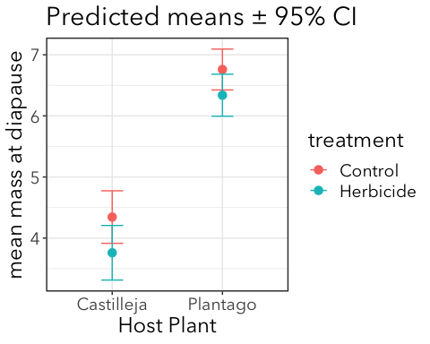
ggplot(plotdata, aes(x = host, y = mass, color = treat)) + geom_point(size = 3) + geom_errorbar(aes(ymin = ci.lower, ymax = ci.upper), width = 0.2) + labs(title = "Predicted means ± 95% CI", x = "Host Plant", y = "mean mass at diapause", color = "treatment")

Slide 15

Lower CI of control doesn’t overlap mean for herbicide
Upper CI of herbicide doesn’t overlap mean of control
= significantly different at p<0.05

Slide 16
Plotting data and means
It’s a good idea to plot raw data in addition to means ± some measure of uncertainty. BUT, it can get ugly looking fast.
Some tips for keeping things readable:
For categorical predictors like this, “jitter” points to make them more visible
Use alpha to make raw data more transparent and fade into the background
“dodge” data to separate groups
Use different symbols for means and data points
Make symbols for means larger than data points
Don’t include raw data if it severely compromises readability of the plot

Slide 17
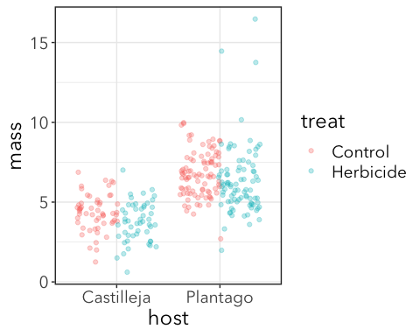
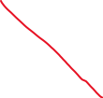
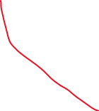
Start with raw data
p1 <- ggplot(cats, aes(x = host, y = mass, color = treat)) + geom_jitter(alpha = 0.3, position = position_jitterdodge()) p1
Plot groups side-by-side + jitter
Transparency

Slide 18
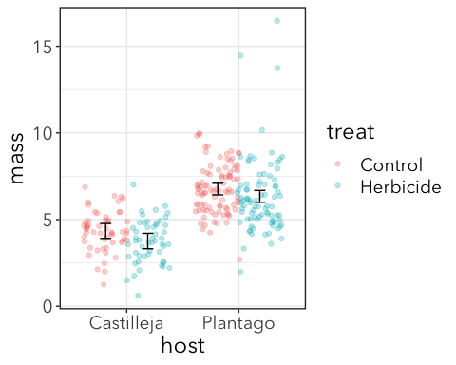



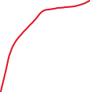
Add error bars first because I want them to be behind the points for means
p2 <- p1 + geom_errorbar(data = plotdata, aes(ymin = ci.lower, ymax = ci.upper, group = treat), color = "black", width = 0.2, position = position_dodge(width = 0.75)) p2
Keep error bars separate, but don’t color differently
I just fiddled with this until it matched the error bars were about in the middle of the point clouds

Slide 19
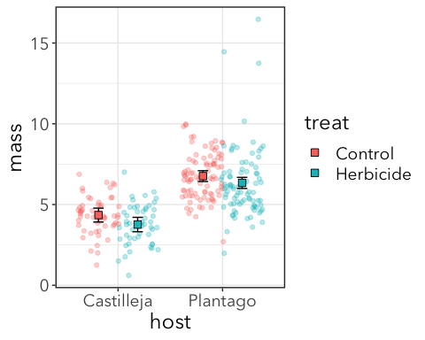






Add means with same dodge
p3 <- p2 + geom_point(data = plotdata, aes(fill = treat), size = 3, shape = "square filled", color = "black", position = position_dodge(width = 0.75)) p3
For filled shapes, color = outline, fill = fill
Same dodge as error bars

Slide 21
Another factorial experiment

Slide 22
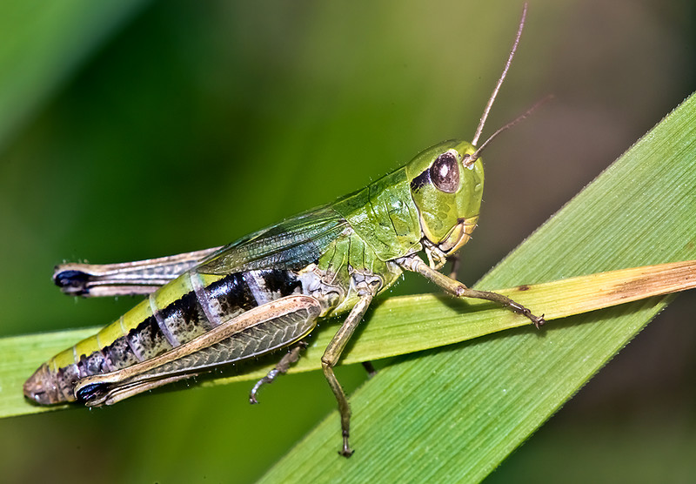
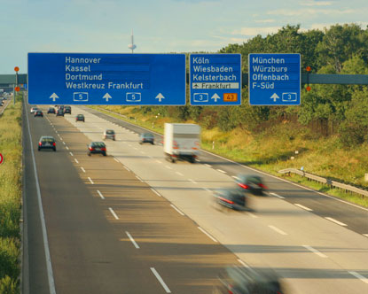
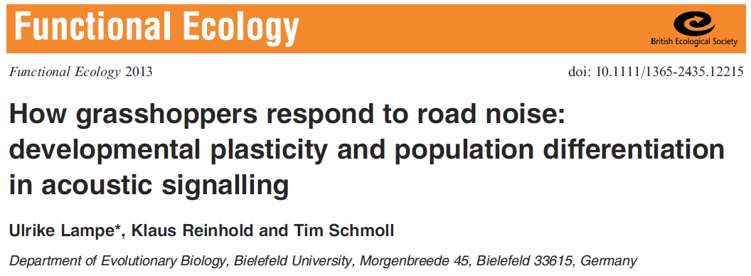
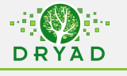
Bow-winged grasshoppers: (Chorthippus biguttulus)
Does road noise affect grasshopper song?
Factorial experiment:
2 source populations: near and far from roads
2 rearing environments: noisy and quiet
How does noise affect the pitch at which grasshoppers “sing”?

Slide 23

Use a factorial glm and “marginal” hypothesis tests to evaluate the effects of source population, rearing environment and their interaction on grasshopper pitch.
Quick overview (ppt)
You run the code (in R)
QUIET PITCH
NOISY PITCH

Slide 24
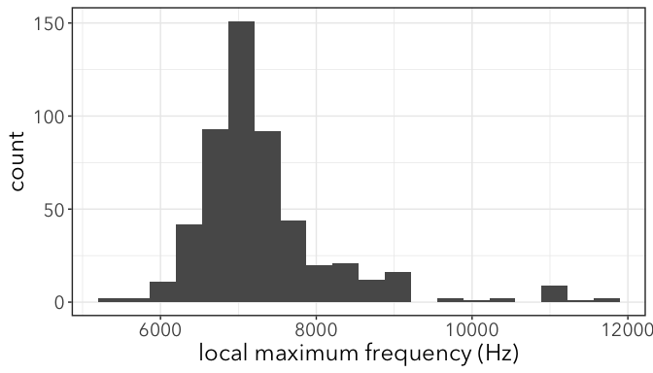
1. Choose a probability distribution
Continuous
Approximately(?) bell shaped & symmetric
Probably close enough to Normal (AKA Gaussian)

Slide 25

2. Fit “full” model & marginal hypothesis test
2 dummy variables:
O (origin) = 1 if roadside, 0 if non-roadside
T (treatment) = 1 if noisy, 0 if quiet
$$E[x_{i}]=β_{0}+β_{1}O+β_{2}T+β_{3}OT$$
m1 <- glm(LocMax ~ Origin*Treatment, family = gaussian, data = gh)

Slide 26
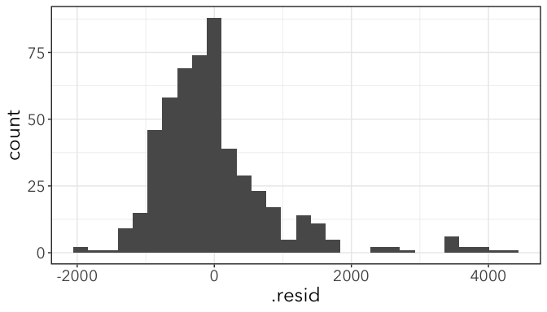
Check that residuals are ± normal
Not great, but not terrible

Slide 27
Marginal Hypothesis test
Anova(m1)
## Analysis of Deviance Table (Type II tests) ## ## Response: LocMax ## LR Chisq Df Pr(>Chisq) ## Origin 21.7862 1 3.048e-06 ***
## Treatment 11.4343 1 0.000721 ***
## Origin:Treatment 0.5008 1 0.479145
Origin + Treat
vs.
Treat
Origin + Treat
vs.
Origin
Origin + Treat + Origin:Treat
vs.
Origin + Treat

Slide 28
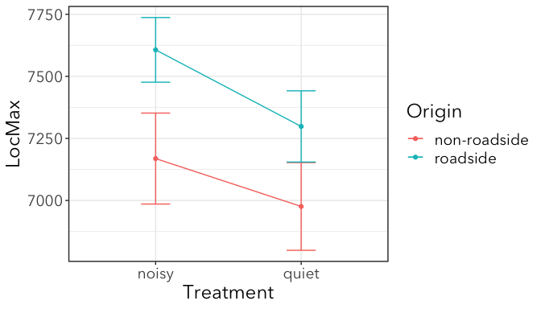
Interaction plot
Use the “hack” to get means and confidence intervals and plot them.
Make interaction plot (not dodged jitter like before)
If there is no interaction, these lines would be parallel. (Why? Work through the algerbra.)

Slide 29
Try in R
grasshopper_song.csv on Canvas
Read it in, fit the glm that test for effects of Treatment, Origin, and their interaction on LocMax (local maximum frequency in Hz)

Slide 30
Use a factorial glm and “marginal” hypothesis tests to evaluate the effects of source population, rearing environment and their interaction on grasshopper pitch.
A possible mechanism for why grasshoppers have higher pitch if they are from noisy environments:
Smaller animals make higher-pitched sounds
Roadside is low-quality habitat (or noise is stressful), so grasshoppers are smaller
Evaluate these hypotheses, using a glm to test each hypothesis
QUIET PITCH
NOISY PITCH

Slide 31
Use a factorial glm and “marginal” hypothesis tests to evaluate the effects of source population, rearing environment and their interaction on grasshopper pitch.
A possible mechanism for why grasshoppers have higher pitch if they are from noisy environments:
Smaller animals make higher-pitched sounds
Roadside is low-quality habitat (or noise is stressful), so grasshoppers are smaller
Evaluate these hypotheses, using a glm to test each hypothesis
QUIET PITCH
NOISY PITCH

Slide 32
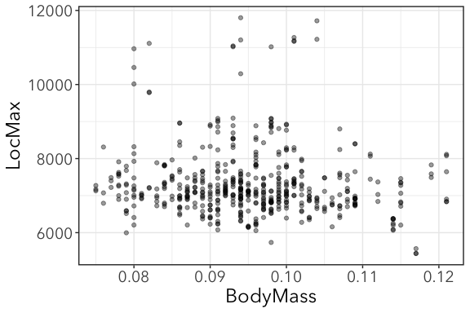
Do smaller grashoppers make higher-pitched sounds?
Test with GLM of song pitch vs. body size

Slide 33
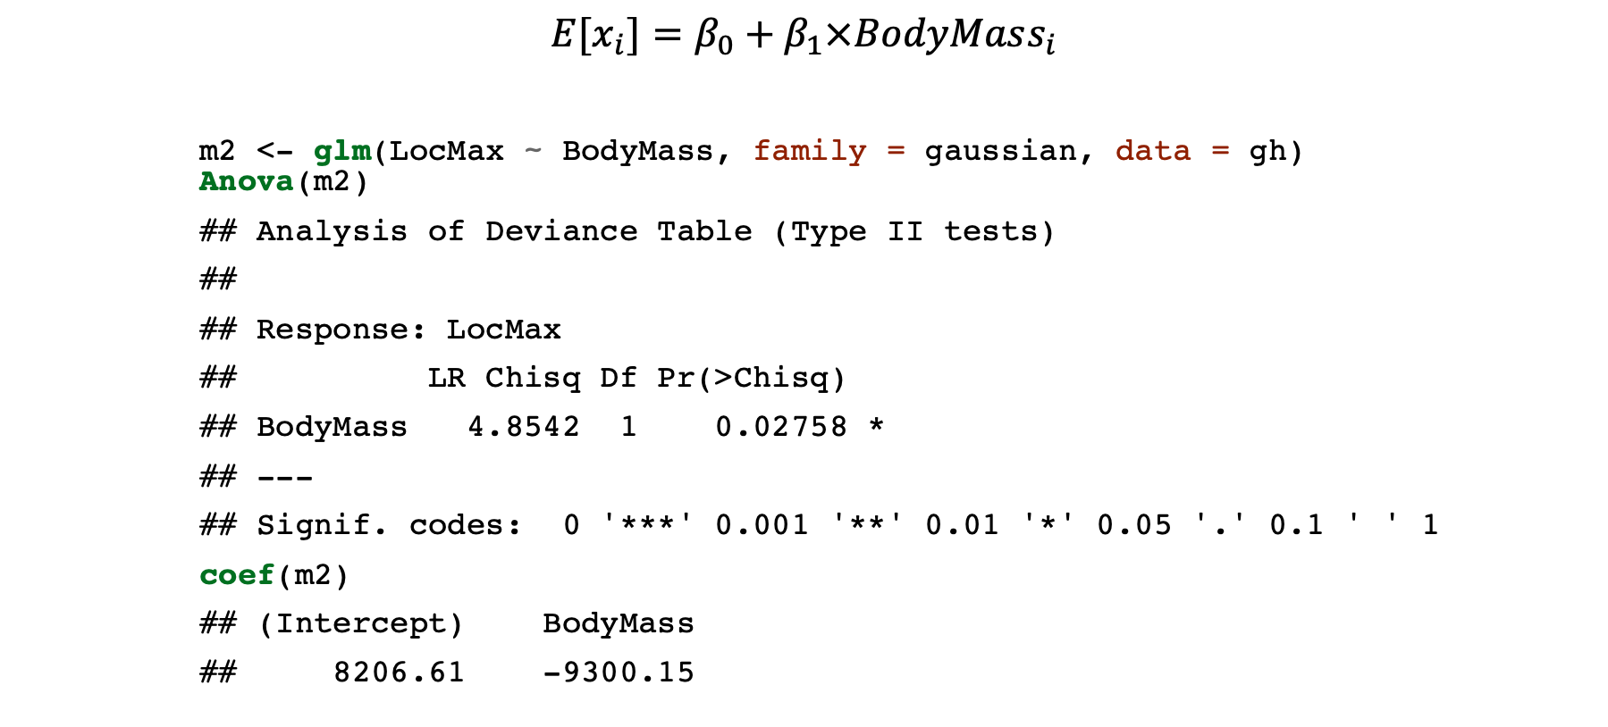
Regression GLM
$$E[x_{i}]=β_{0}+β_{1}×BodyMass_{i}$$
m2 <- glm(LocMax ~ BodyMass, family = gaussian, data = gh) Anova(m2)
## Analysis of Deviance Table (Type II tests) ## ## Response: LocMax ## LR Chisq Df Pr(>Chisq) ## BodyMass 4.8542 1 0.02758 * ## --- ## Signif. codes: 0 '***' 0.001 '**' 0.01 '*' 0.05 '.' 0.1 ' ' 1
coef(m2)
## (Intercept) BodyMass ## 8206.61 -9300.15

Slide 34
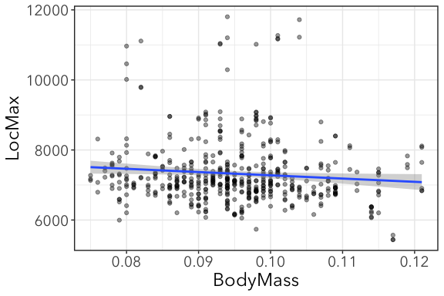
Plot the best fit line ± CI
To plot a best fit line, we can use geom_smooth()
NOTE: this only works well for simple models. Use with caution.
massplot + geom_smooth(method = "glm", level = 0.95, method.args = list(family = gaussian)

Slide 35
Why are CIs wider at extremes?
Confidence in intercept AND slope means less confident about about extreme values.

Slide 36
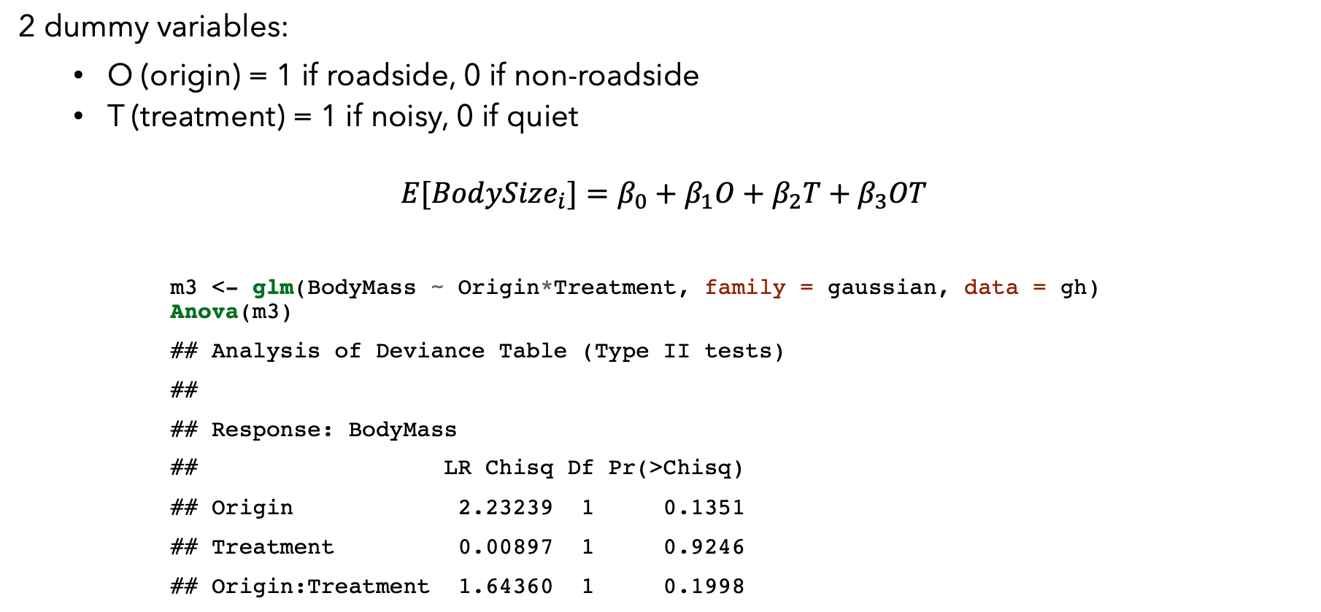
Does habitat origin affect body size?
2 dummy variables:
O (origin) = 1 if roadside, 0 if non-roadside
T (treatment) = 1 if noisy, 0 if quiet
$$E[BodySize_{i}]=β_{0}+β_{1}O+β_{2}T+β_{3}OT$$
m3 <- glm(BodyMass ~ Origin*Treatment, family = gaussian, data = gh) Anova(m3)
## Analysis of Deviance Table (Type II tests) ## ## Response: BodyMass ## LR Chisq Df Pr(>Chisq) ## Origin 2.23239 1 0.1351 ## Treatment 0.00897 1 0.9246 ## Origin:Treatment 1.64360 1 0.1998

Slide 37
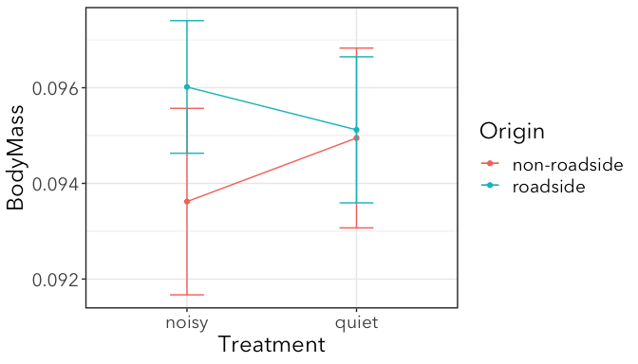
No significant effect of origin or treatment or their interaction on mass

Slide 38
Use a factorial glm and “marginal” hypothesis tests to evaluate the effects of source population, rearing environment and their interaction on grasshopper pitch.
A possible mechanism for why grasshoppers have higher pitch if they are from noisy environments:
Smaller animals make higher-pitched sounds
Roadside is low-quality habitat (or noise is stressful), so grasshoppers are smaller
YES
NO
QUIET PITCH
NOISY PITCH

Slide 39
Body size, origin, and treatment all affect song pitch in separate models

Slide 40
Use a factorial glm and “marginal” hypothesis tests to evaluate the effects of source population, rearing environment and their interaction on grasshopper pitch.
A possible mechanism for why grasshoppers have higher pitch if they are from noisy environments:
Smaller animals make higher-pitched sounds
Roadside is low-quality habitat (or noise is stressful), so grasshoppers are smaller
Joint effects of both body size & noise…
QUIET PITCH
NOISY PITCH

Slide 41
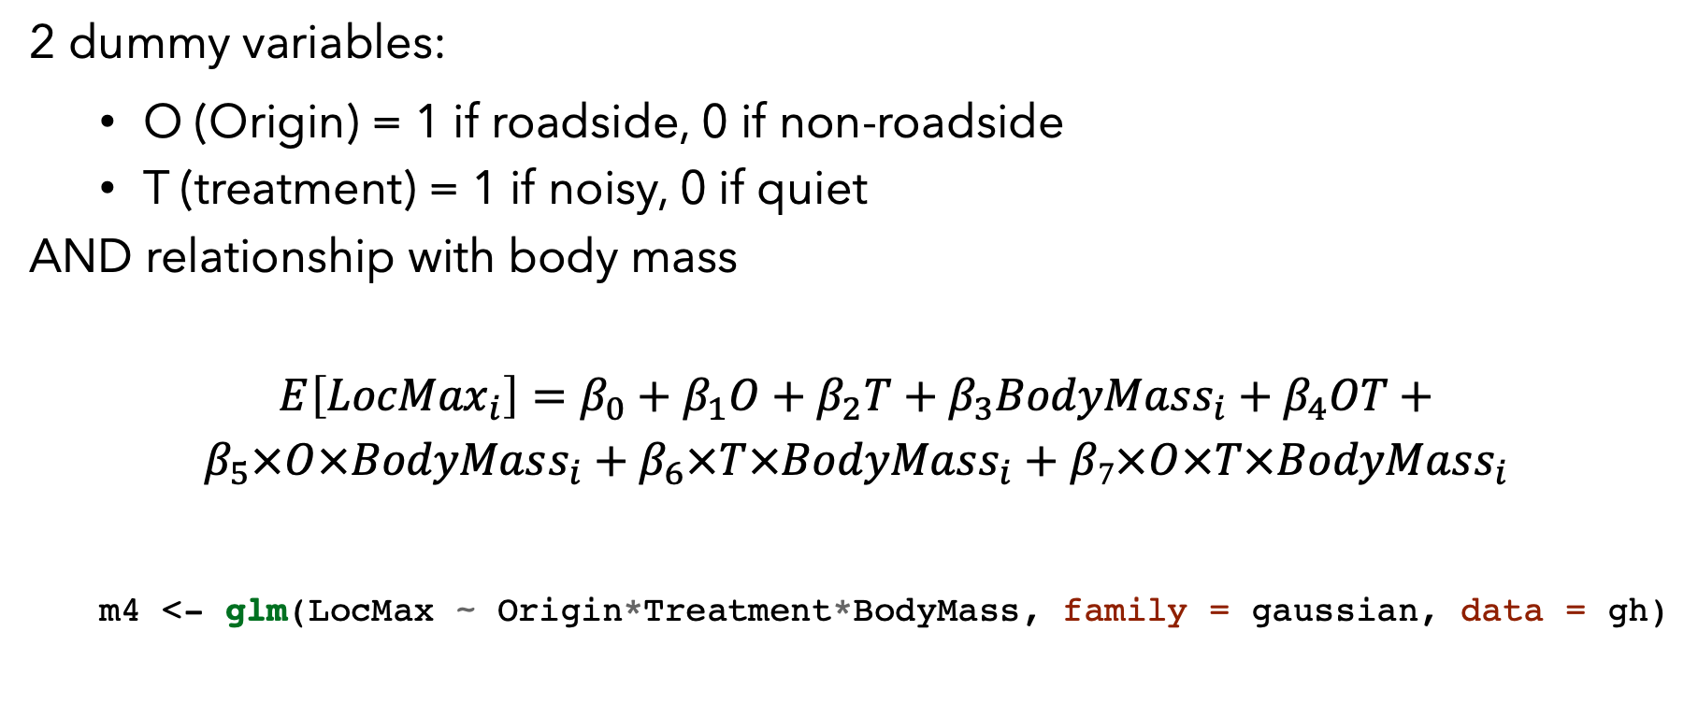
Interaction of body mass and noise
2 dummy variables:
O (Origin) = 1 if roadside, 0 if non-roadside
T (treatment) = 1 if noisy, 0 if quiet
AND relationship with body mass
$$E\left[{LocMax}_{i}\right]=β_{0}+β_{1}O+β_{2}T+β_{3}BodyMass_{i}+β_{4}OT+$$
$$β_{5}×O×BodyMass_{i}+β_{6}×T×BodyMass_{i}+β7×O×T×BodyMass_{i}$$
m4 <- glm(LocMax ~ Origin*Treatment*BodyMass, family = gaussian, data = gh)

Slide 42
## glm(formula = LocMax ~ Origin * Treatment * BodyMass, family = gaussian, ## data = gh)
Anova(m4)
## Analysis of Deviance Table (Type II tests) ## ## Response: LocMax ## LR Chisq Df Pr(>Chisq) ## Origin 23.9022 1 1.014e-06 *** ## Treatment 12.0041 1 0.0005308 *** ## BodyMass 7.0858 1 0.0077699 ** ## Origin:Treatment 0.7817 1 0.3766350 ## Origin:BodyMass 1.0395 1 0.3079399 ## Treatment:BodyMass 0.6213 1 0.4305612 ## Origin:Treatment:BodyMass 0.3728 1 0.5414588 ## --- ## Signif. codes: 0 '***' 0.001 '**' 0.01 '*' 0.05 '.' 0.1 ' ' 1
No significant interactions (whew). That means effects of mass, origin, and treatment are simply additive.

Slide 43
Fit simpler additive model
Fit the simpler additive model to get predicted results:
mred <- glm(LocMax ~ Origin + Treatment + BodyMass, family = gaussian, data = gh)

Slide 44
Plotting results
geom_smooth() won’t work here because it’s going to plot lines and confidence intervals for the full model.
We have to build our own plot. Here’s one way:
Get fitted values and standard error as a data frame with augment() from the broom package
library(broom) pred <- augment(mred) head(pred %>% select(LocMax, Origin, Treatment, BodyMass, .fitted, .se.fit))
## # A tibble: 6 x 6 ## LocMax Origin Treatment BodyMass .fitted .se.fit ## <dbl> <chr> <chr> <dbl> <dbl> <dbl> ## 1 7193 non-roadside noisy 0.084 7318. 87.1 ## 2 7239 non-roadside noisy 0.084 7318. 87.1 ## 3 7358 non-roadside noisy 0.084 7318. 87.1

Slide 45
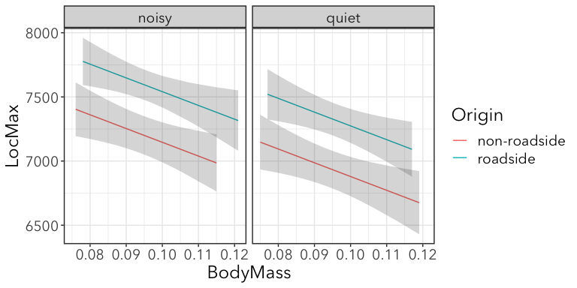
No interaction = parallel lines
Significant additive effects = non-overlapping 95% confidence intervals

Slide 46


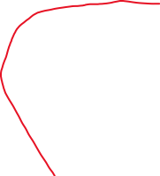
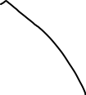



ggplot2 code
ggplot(pred, aes(x = BodyMass, y = .fitted, color = Origin)) + geom_line(aes(group = Origin)) + geom_ribbon(aes(ymin = .fitted - .se.fit * 1.96, ymax = .fitted + .se.fit * 1.96, group = Origin), alpha = 0.2, color = NA) + facet_wrap(~Treatment)
We’ll talk about standard errors and their relationship to confidence intervals another time
Plot ribbons separately, but don’t color them differently
Takes away lines at edges of ribbons

